Slide 1


BSC Budget Plan Group 8 E01 Project
TEAM MEMBERS
JESSICA NEBELSICK
SRIJA REDDY YEDULLA
MADHUKIRAN REDDY SUNKARA
JOSHUA ALBERA-HAGERICH
AVINASH REDDY VINJAMURI
SRI SAI CHARAN KARNATI

Slide 2
Objective & Executive Summary
Baseline Budget Scenarios (2020-2022): Steady growth trajectory with Electronics leading revenue contribution.
Variance Analysis Findings: Positive and negative trends observed across product categories and regions, influencing revenue forecasting and budget planning.
Stretch Budget Scenarios: Incremental revenue growth projected above baseline forecasts.
New Product Suggestions and Growth Requirements: Opportunities identified for tech accessories, subscription services, and home entertainment products to drive growth.

Slide 3
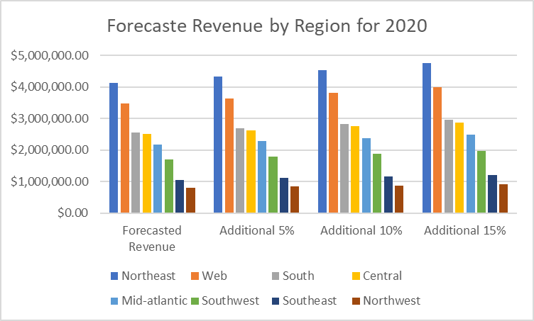
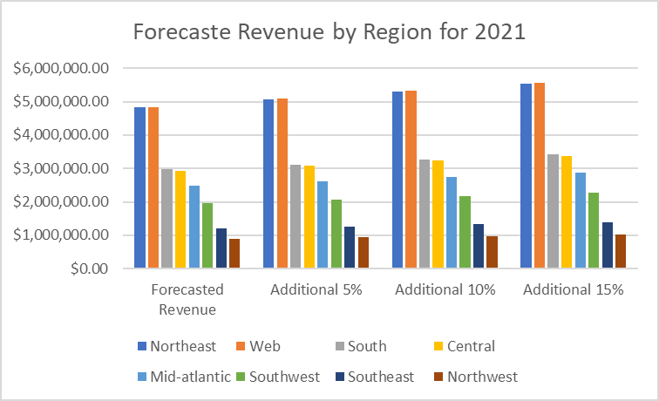
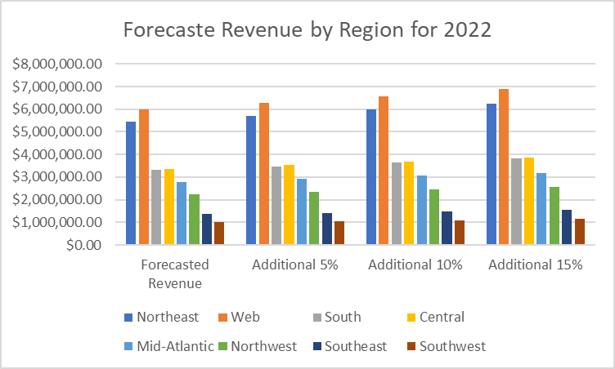
Forecasting Revenue By Region
Revenue growth that is consistent across all regions from the year 2020 to the year 2022.
Even if every area grows, not all of them do it at the same rate. Although some regions, like the Northeast and Web category, display faster growth rates and larger absolute sales figures, others, like the Southeast and Southwest, display slower growth rates.
Additional predictions of revenue provide the opportunity to gain insights into future growth plans.

Slide 4
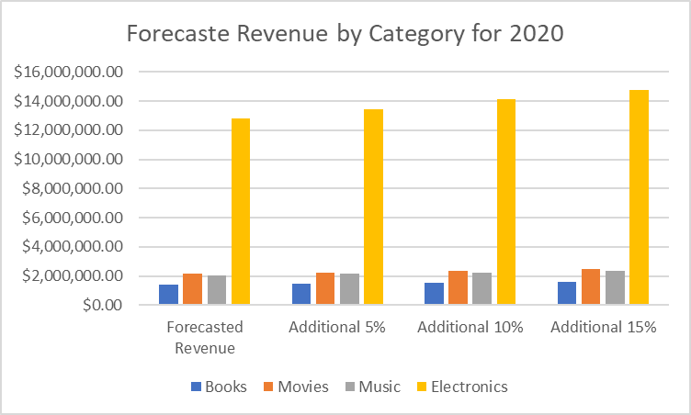
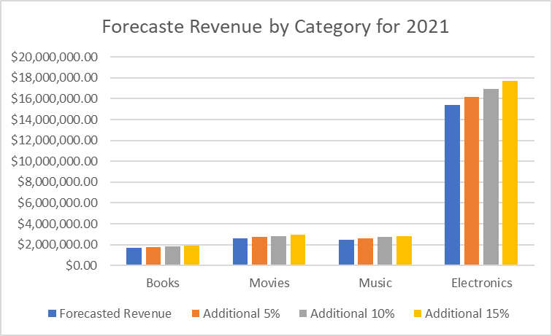
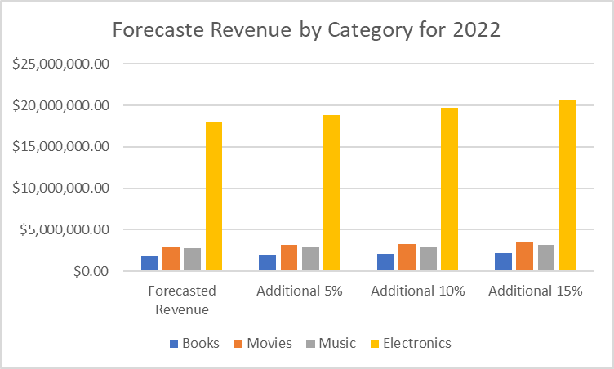
Forecasting Revenue By Category
There is a clear upward trend in revenue from 2020 to 2022 across all product categories, which bodes well for the growth of the market and the demand from consumers.
With 5%, 10%, and 15% increments, the potential impact of incremental revenue grows, revealing how each category's revenue scales.
A company's long-term success depends on its ability to use the insights provided by its revenue forecasts to make educated decisions and launch strategic projects that will bring in more money.

Slide 5
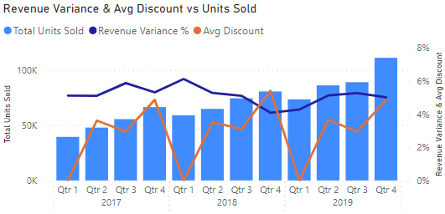
Variance Analysis
Positive but declining each year:
2017: strong positive variances in several regions
2018: average discount increased as total units increased, and multiple categories and subcategories declining in multiple regions
2019: several of the categories and subcategories that declined in 2018 recovered
At the Region level:
Northwest region has the highest variance across years (5.62%)
Southwest has the lowest (4.50%)
At the Category level:
Music has the highest variance across years (5.41%), increasing each year
Electronics is the highest in dollar terms and some categories seem to follow a pattern

Slide 6
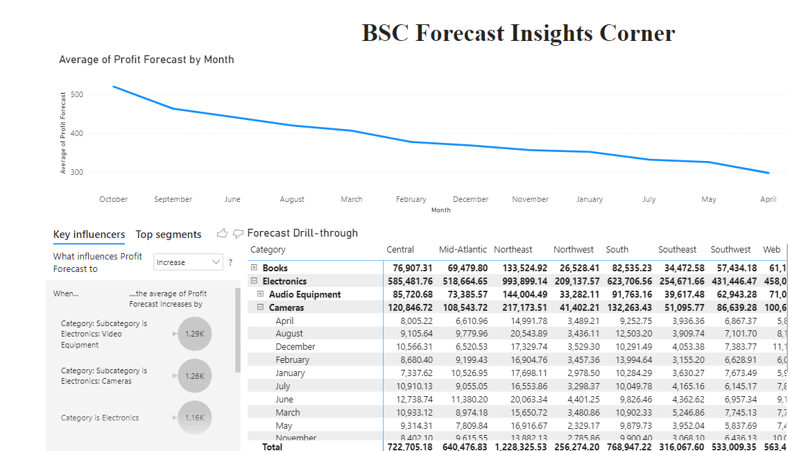
Dashboards & Reports

Slide 7
Dashboards & Reports

Slide 8

Recommendations
Maintain Focus on the Electronics Product Line
Enhance Marketing and Brand Recognition
Strengthen Support and Presence for E-Commerce
Extend Product Offering: Value-Added Services and Subscriptions
Create a Supply Chain with a Vertical Integration Approach

